Slide 1
zekeLabs
Cassandra - Introduction
Learning made Simpler ! www.zekeLabs.com

Slide 2
What is Cassandra ?
Cassandra History
NoSQL cassandra database
NoSQL cassandra database vs RDBMS
Cassandra Features
Cassandra Use Cases/Application
Agenda

Slide 3
What is Cassandra ?
Distributed DBMS.
Meant for high volume of structured data.
HW is commodity servers
Seamlessly scaleable.
Superfast writes
More than one replication factor ensures high availability

Slide 4
Cassandra History
Developed by facebook for inbox search.
Open sourced in 2008
Apache took over in 2009
One of the top project since 2010
Latest version 3.x.x

Slide 5
NoSQL Database
Stands for not only SQL
Suitable for massive volumes of data
Unlike relational databases, no relations between tables.
MongoDb, HBase are other examples
Horizontal scaling
High availability

Slide 6
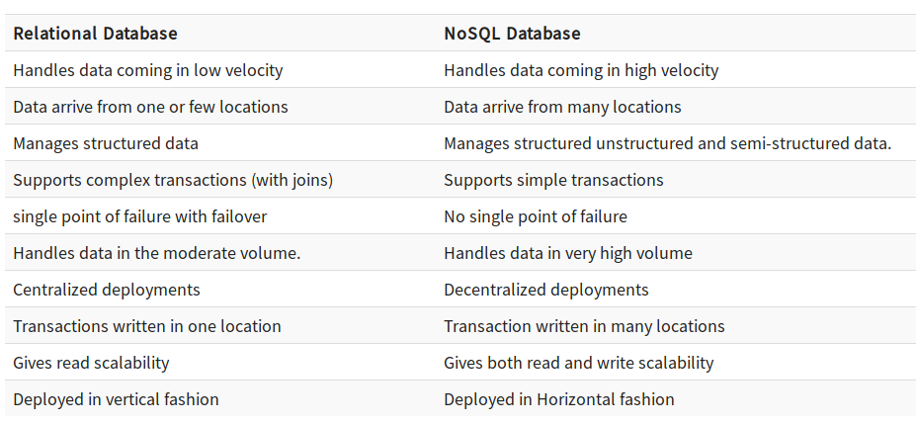
Cassandra vs RDBMS

Slide 7
Cassandra Features
Massively Scalable Architecture:
Masterless Architecture:
Linear Scale Performance:
No Single point of failure:
Fault Detection and Recovery:
Data Protection:
Tunable Data Consistency:
Multi Data Center Replication:
Data Compression:
Cassandra Query language:

Slide 8
Cassandra Applications
Messaging
Internet of Things
Product Catalogs and retail apps
Social Media Analytics and recommendation engine

Slide 9
Thank You !!!

Slide 10
THANK YOU
Let us know how can we help your organization to Upskill the employees to stay updated in the ever-evolving IT Industry.
Get in touch:
www.zekeLabs.com | +91-8095465880 | info@zekeLabs.com
Visit : www.zekeLabs.com for more details

